Slide 1
Practical Microsoft Bot Framework for Office 365 developers
SharePoint Saturday Helsinki, January 2018
Olli Jääskeläinen @_opax

Slide 2





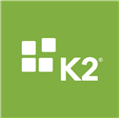


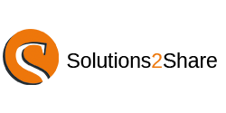


Thank you to our sponsors!

Slide 3

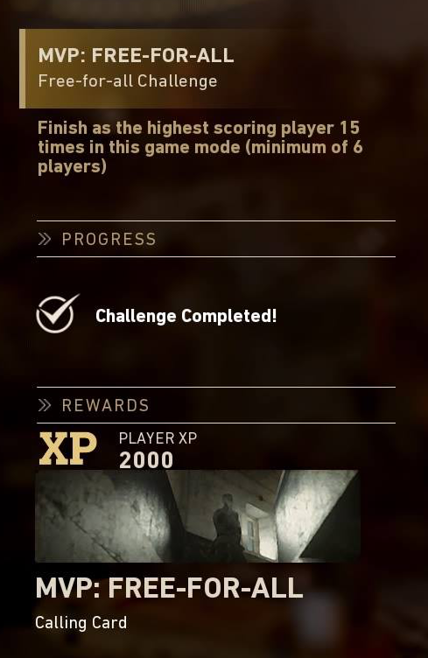
Olli Jääskeläinen @_opax
Microsoft MVP, MCM, MCT
Lead architect, Collaboration & AI
at Sulava.com
Office 365 & SharePoint User Group Finland organizer

Slide 4
Agenda
What Bots, and why Bots?
Getting the concepts straight
Building Bots
Utilizing the Microsoft Teams channel
Call for action!

Slide 5
Agenda
What Bots, and why Bots?
Getting the concepts straight
Building Bots
Utilizing the Microsoft Teams channel
Call for action!

Slide 6
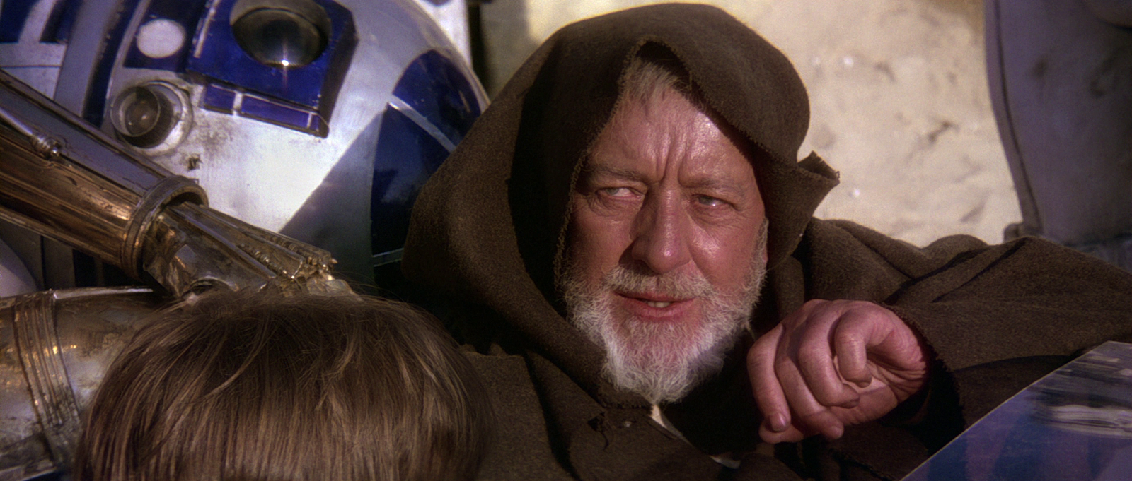
What kind of bots we are looking for?

Slide 7
We are not focusing on…
Physical bots such as droids and automated drones
Internet bots such as search crawlers, at least not directly

Slide 8
We are focusing on…
Bots which communicate with human users via instant messaging
Bots which we can deploy to Office 365
Bots which are created using Microsoft Bot Framework and are made available through Azure Bot Service

Slide 9
From Wikipedia…
A software agent is a computer program that acts for a user or other program in a relationship of agency, ... Agents are colloquially known as bots, from robot.
A chatbot (also known as a talkbot, chatterbot, Bot, IM bot, interactive agent, or Artificial Conversational Entity) is a computer program which conducts a conversation via auditory or textual methods.

Slide 10
Why Bots?
In 2038, digital devices will help us do more with one of our most precious commodities: time.
From ’The Future Computed’
January 2018 https://msblob.blob.core.windows.net/ncmedia/2018/01/The-Future-Computed.pdf

Slide 11
Why Bots?
Bots are apps with a different but useful user interface
Bots can (but they don’t have to) utilize artificial intelligence services
Bots can save time (=money)

Slide 12
Agenda
What Bots, and why Bots?
Getting the concepts straight
Building Bots
Utilizing the Microsoft Teams channel
Call for action!

Slide 13
Agenda
What Bots, and why Bots?
Getting the concepts straight
Building Bots
Utilizing the Microsoft Teams channel
Call for action!

Slide 14
Azure Bot Service
Microsoft’s cloud service for building, connecting, testing, monitoring and managing bots
Generally Available since December 2017

Slide 15
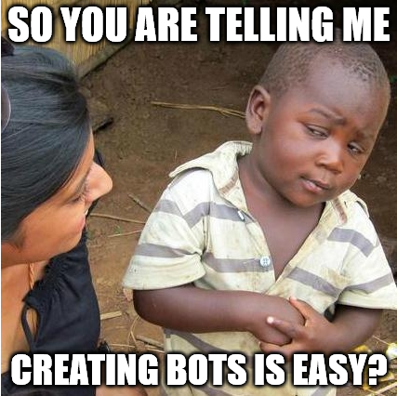
DEMO
Creating Azure Bot Service Bot
Testing the Bot
Embedding Bot to SharePoint page

Slide 16
Web App Bot
An Azure Bot Service entity which includes a bot
Hosted using App Service Plan – as web sites or Consumption Plan – as Azure Functions

Slide 17
Microsoft Bot Framework toolset
Can utilize Azure Bot Service as platform or run virtually anywhere (Azure, on-prem, AWS, …)
Helpful dev aids such as Visual Studio Bot Application template and Bot Framework Channel Emulator

Slide 18
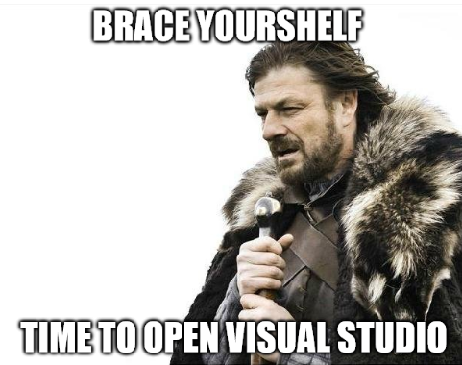
DEMO
Visual Studio Bot Application Template
Bot Framework Channel Emulator
Bot Builder SDK:
https://docs.microsoft.com/en-us/bot-framework/dotnet/bot-builder-dotnet-quickstart

Slide 19
Channels
A channel is connection between the bot and an app
Microsoft Teams, Web Chat, Email, Skype for Business
Direct Line
Bing, Cortana, Facebook, Kik, Skype, Slack, Telegram Twilio

Slide 20
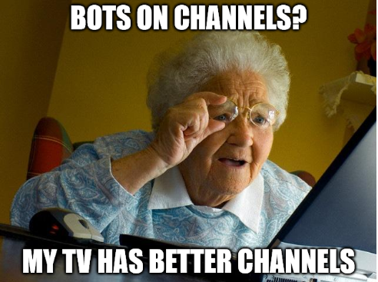
DEMO
How to configure channels

Slide 21
Agenda
What Bots, and why Bots?
Getting the concepts straight
Building Bots
Utilizing the Microsoft Teams channel
Call for action!

Slide 22
Agenda
What Bots, and why Bots?
Getting the concepts straight
Building Bots
Utilizing the Microsoft Teams channel
Call for action!

Slide 23
QnA Maker
https://qnamaker.ai/
The no-code approach for making bots, using ready made AI components and suitable content

Slide 24
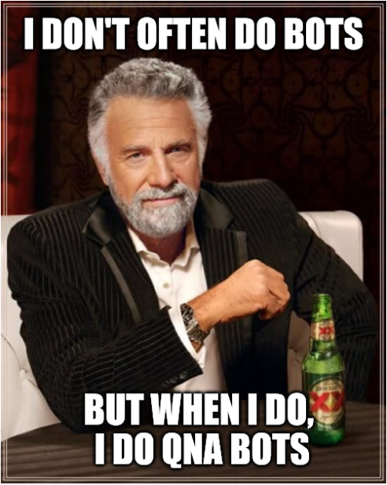
DEMO
Create QnA knowledge base
Pair it with your Azure Bot Service QnA Bot

Slide 25
Forms
FormFlow automatically creates dialogs based on data model
You can use c# classes or JSON schema to present the data model

Slide 26
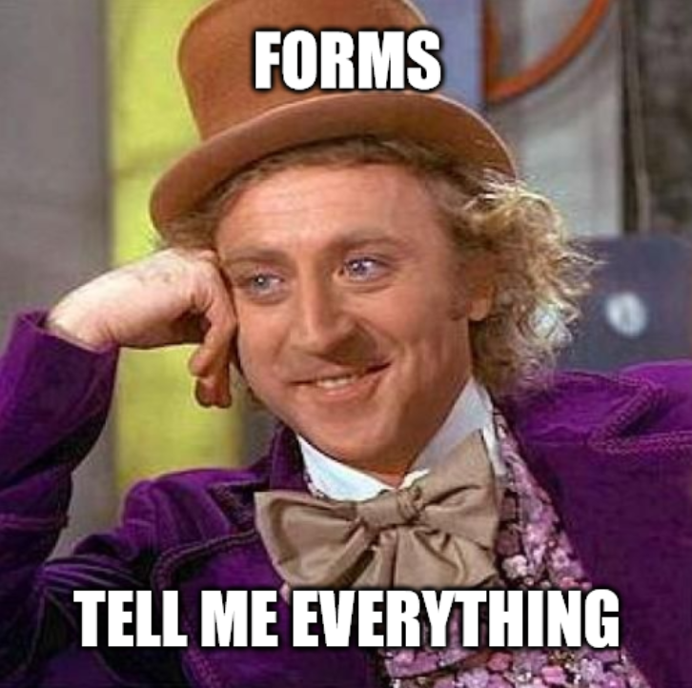
DEMO
Examining Forms Bot
Notes:
https://hellosps2018helsinkiform2.scm.azurewebsites.net/dev/wwwroot/Models/Sandwich.cs

Slide 27
Working with message information
Message has properties like channel, mentions and attachments – we can work on this data
When message is received, the bot can send multiple replies

Slide 28
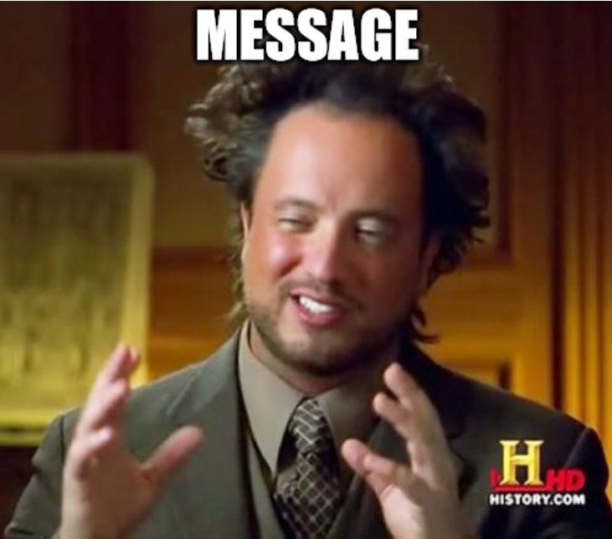
DEMO
Working with message information

Slide 29
Agenda
What Bots, and why Bots?
Getting the concepts straight
Building Bots
Utilizing the Microsoft Teams channel
Call for action!

Slide 30
Agenda
What Bots, and why Bots?
Getting the concepts straight
Building Bots
Utilizing the Microsoft Teams channel
Call for action!

Slide 31
Adding your bot to Microsoft Teams
Create, test and deploy the bot
Craft bot manifest file and icons
Package the files
Upload the package to Microsoft Teams
Add the bot to a channel

Slide 32
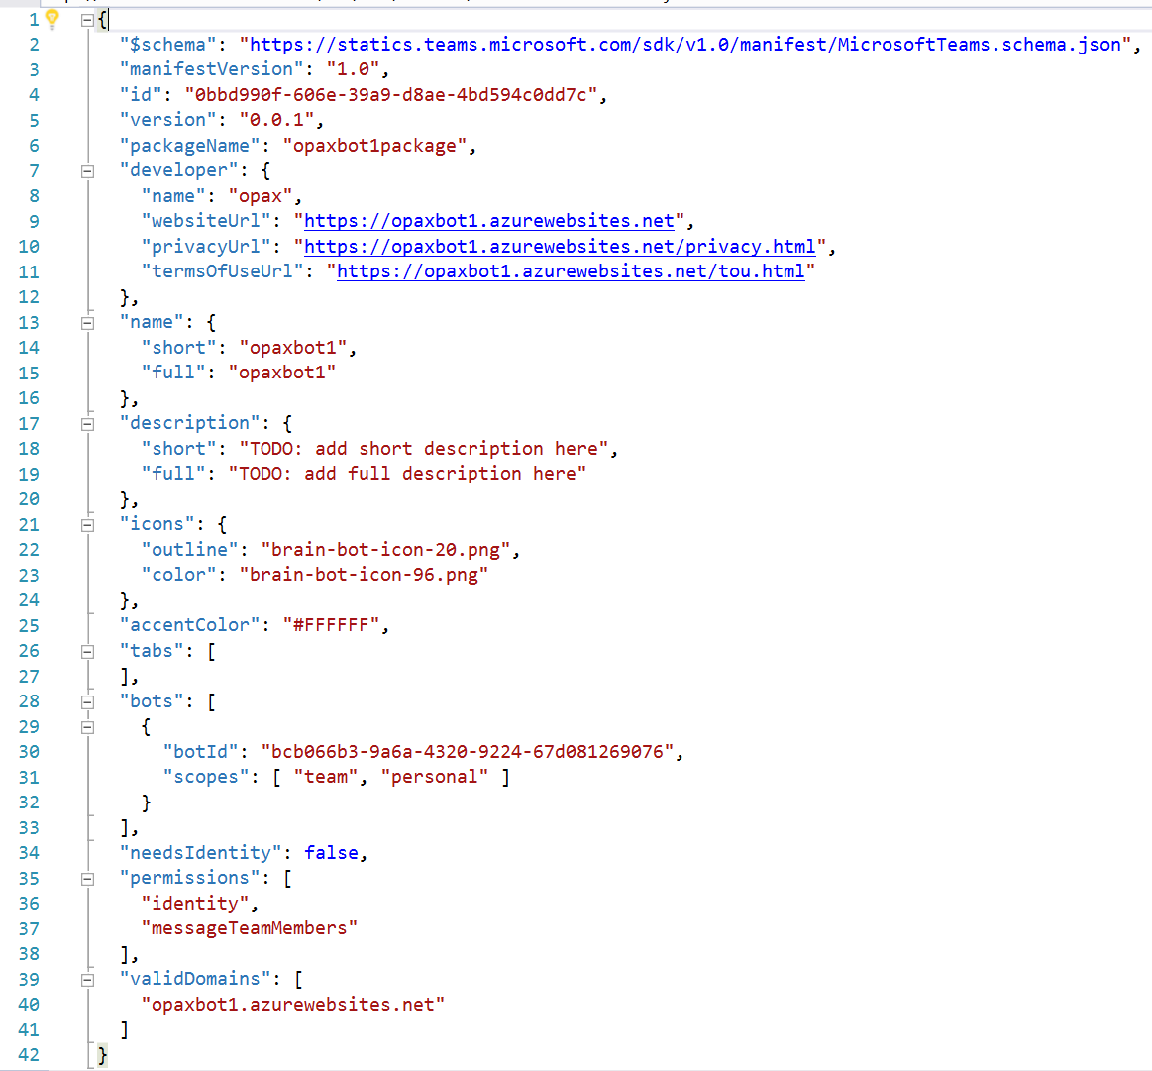
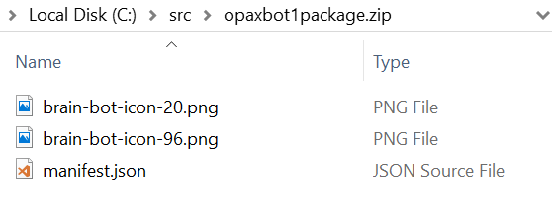
Sample
A blog post coming soon!

Slide 33
Agenda
What Bots, and why Bots?
Getting the concepts straight
Building Bots
Utilizing the Microsoft Teams channel
Call for action!

Slide 34
Agenda
What Bots, and why Bots?
Getting the concepts straight
Building Bots
Utilizing the Microsoft Teams channel
Call for action!

Slide 35
Key takeaways
Building and deploying bots is surprisingly easy
You need Azure Subscription and some time
Microsoft Teams is currently the best but not only channel for your bots in Office 365

Slide 36
Call for action!
Join Office 365 & SharePoint User Group Finland Facebook and Meetup groups
https://www.facebook.com/groups/spugfi/ https://www.meetup.com/spugfi/
Start building a Bot for SPUG Bot competition
Join us here at Microsoft Flux on Monday 26th of February!

Slide 37
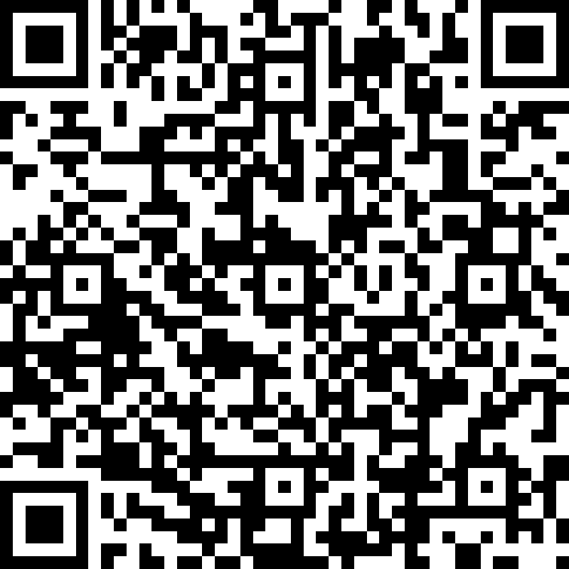
Thank you!
Please rate this session
bit.ly/spshel2018

